Slide 1
Deliverable 2

Slide 2
Interview Synopsis
Meeting User Needs:
Catering to diverse needs of students, faculty, and staff
Providing consistent experience with MyUmbc website
Key functionalities: MyUmbc portal, profiles, email access
Balancing seamless experience and introducing new features
Data Protection:
Industry-standard encryption for user data security
Secure storage of passwords using iOS and Android features
Access protected through passcodes and biometric authentication
Extensive activity logging for monitoring and threat detection
Maintenance:
Ongoing efforts to keep app functioning smoothly
Regular analysis of crash logs and issue resolution
Updates to accommodate changes in mobile operating systems
Focus on adding web-based features for improved functionality
Project Overview:
MyUmbc app project led by B. Collier Jones
Objective: Establish presence in app store for UMBC users
Provide mobile access to key functionalities and services
Implementation Process:
Development and design assistance from Mind Grub
Focus on iOS development for Mac platform
Wrapper around existing MyUmbc web experience
Tabs for easy navigation, coordination for seamless updates
App Updates:
Infrequent updates, 1 or 2 small updates per year
Transition from version 1.0 to 2.0 with design changes
Tabs moved to bottom for familiar and intuitive UI
Introduction of push notifications, adjusted strategy for DUO integration

Slide 3
Questionnaire Synopsis
Objective: Gather feedback on myUMBC app and identify areas for improvement
9 respondents, all undergraduates
Usage: 44.4% use the app, with varied frequency
Popular Features: Class schedule and grade checking
Mixed responses on effectiveness for campus events and activities
Ratings: Mixed ratings for efficiency, overall experience, and usability
Technical Issues: Lagging, recurring sign-in prompts
Recommendation: Divided responses on recommending the app
Conclusion: Feedback highlights areas for improvement in app functionality and stability

Slide 4
Observation Synopsis
Login failure issue identified during observation of myUMBC application
Interview conducted with project leader, Collier Jones, to address issue and explore improvements
Proposed solution: Create wrapper around myUMBC web experience with native functionality
Challenge with Android compatibility requiring additional development efforts
Proposed improvements:
Grade impact visualization tool for better assignment management
Test average tool for insights on exam scores
Consideration of system overhaul for improved flexibility (with financial and timeline considerations)
Data protection and security emphasized, including logging activities and data purging mechanisms
Maintenance requires monthly fee for crash logs and updates
Conclusion: Observation identified login failure issues, proposed solutions and improvements, and highlighted importance of data protection and Android compatibility.

Slide 5
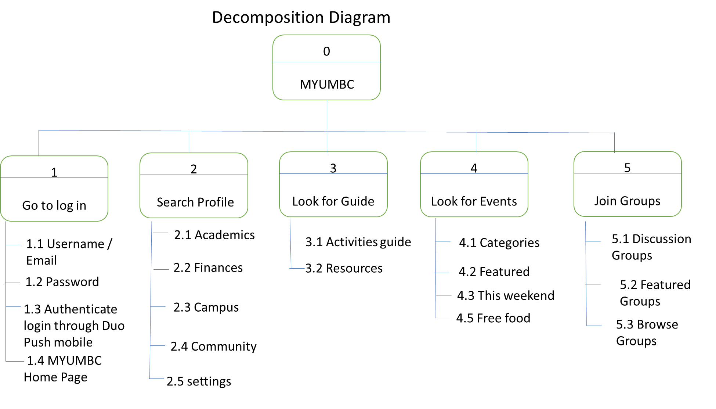

Slide 6
Context level Diagram
Register courses & bill payment
Myumbc & Blackboard access
Username/Email
password
Username/Email
password
Students
0
MYUMBC
Staff
Schedule & campus
resources
profile, schedule grades &
campus resources
Username/Email
password
Faculty
Schedule & campus resources

Slide 7
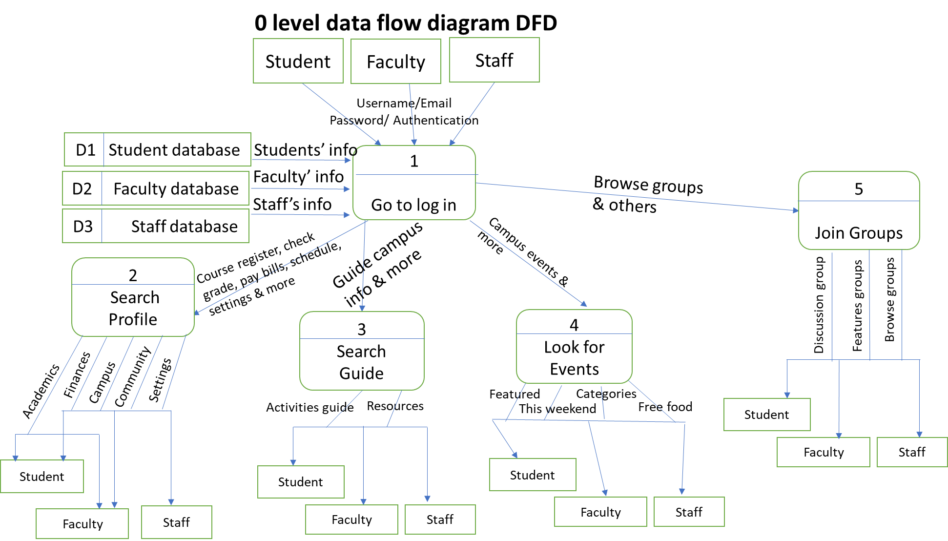

Slide 8
DD Entry for Data Flow
1. Data flow name – Course registration
2. Data flow description – Allow students to register, swap, and drop courses
3. Aliases – my courses, my class, add courses
4. Timing and volume – 15000/semester
5. Data structure – students’ campus ID # (PK), Students’ name, address, phone number, email address, major, time & date.

Slide 9
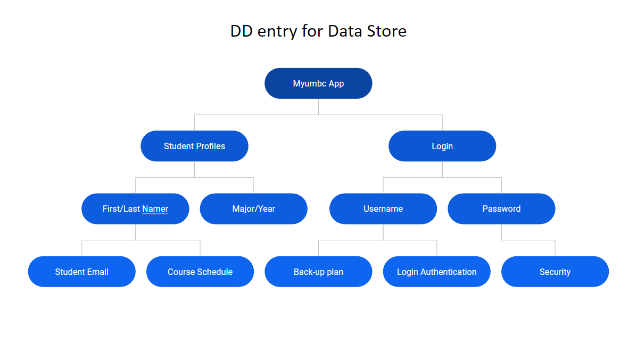

Slide 10
Decision table (Structured English)
IF myumbc improvement costs less than [blank] amount
THEN See if it is compatible web browser application
IF myumbc improvement is compatible with web browser
THEN Make improvement
ELSE make no improvements to the application
ENDIF

Slide 11
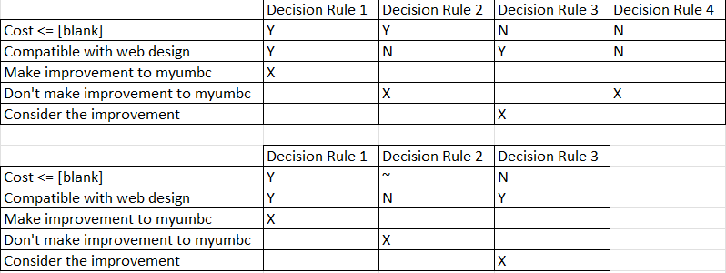
Decision table

